Slide 1
Customer Segment Analysis
In this presentation, we will analyze different customer segments and their characteristics. We will identify key insights to help improve business strategies and customer targeting.

Slide 2
Introduction
Analysis
Modeling & MLOps
Business Recommendations

Slide 3
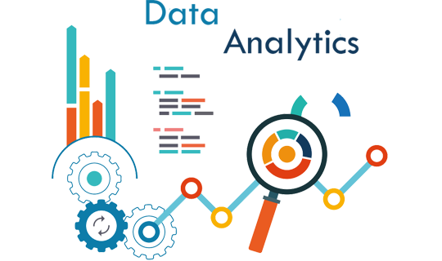
Data Analysis
Performed EDA to understand the data.
The original dataset consists of 66083 records and 30 features.
EDA
Deduplication
Remove Data Anomalies
Feature selection by domain knowledge
Data Type Conversion

Slide 4
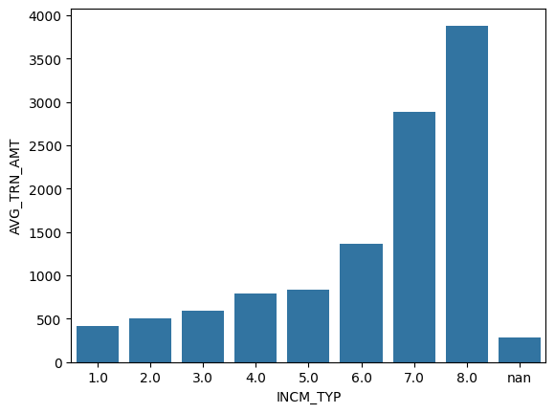
Data Analysis (..contd)
Is there a relation between average transaction amount and income level code?
The graph signifies that higher the income level code higher the average transaction amount.
Safe to assume that higher the income level code indicates higher income value.

Slide 5
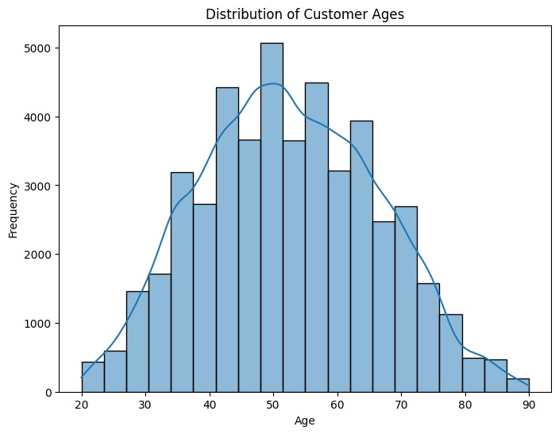
Data Analysis (..contd)
What is the distribution of customer ages in the dataset?
Indicates majority of the customers are middle aged people.
Most number of customers fall under the age between 45 to 50.

Slide 6
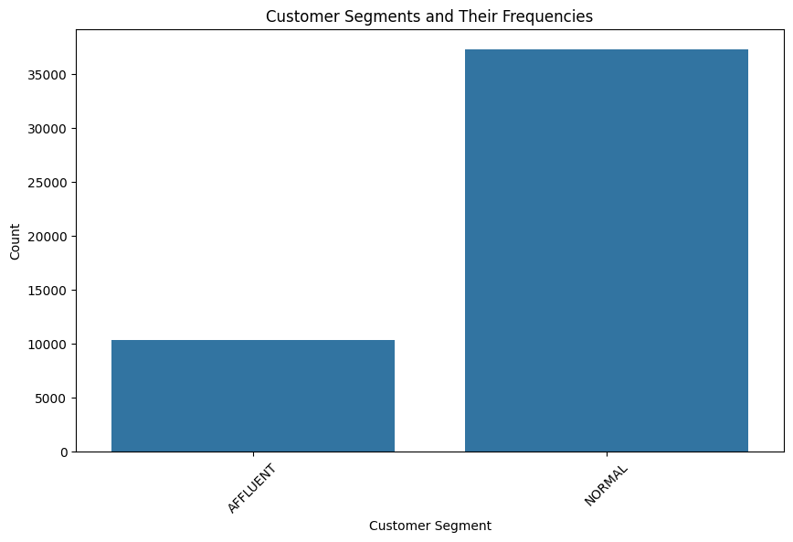
Data Analysis (..contd)
How many Normal & Affluent customers are there in the current dataset?
Currently there are more than 35000 Normal customers.
Goal to find the affluent customers among these normal customers.

Slide 7
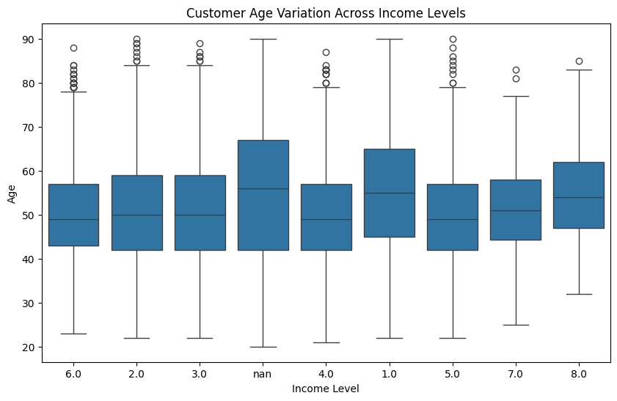
Data Analysis (..contd)
How does customer age vary across different income levels?
Higher income level code signifies higher income.
Income level code 1 as the highest median age among customers, indicating retired or the customers having only passive income like pension.
Income level code 8, has customers majorly between 45 and 60, potentially signifying people might have attained the senior positions in their professions.

Slide 8
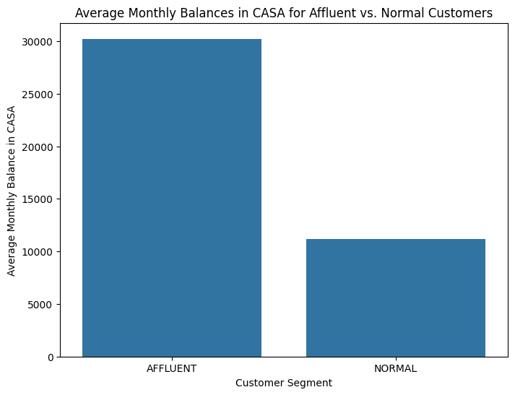
Data Analysis (..contd)
Do affluent customers tend to have higher average monthly balances in CASA compared to normal customers?
The graph indicates that affluent customers have much higher average monthly balances compared to normal customers.

Slide 9
Modeling
Simple Data Imputation
Imputed Median values for the numeric fields to overcome null values.
Ensemble Technique - Random Forest Classifier
Used a simple random forest classifier method from the sklearn package to identify potential affluent customers.
Neural Network Classifier
Used Sequential & Dense layers from the tensorflow package to classify the customers.

Slide 10
MLOps
Model Deployment
Deploy to production using dockers, kubernetes, etc. Ensure scalability.
Model Monitoring
Monitor data distribution, model performance. Identify anomalies.
Model Version Control
Enables easy & safe rollbacks to previous stable versions.
CICD
Automate integrating changes and deploy the model to production using Jenkins, Gitlab, etc.
Model Retraining
Automated pipelines to retrain data using fresh data.
Security & Compliance
Protect sensitive data.
Regularly audit and review the model and deployment infrastructure.

Slide 11

Conclusion
Important correlation among age, income, transaction amount and savings amount.
Potential Affluent Customers;
Average of 57
Average monthly savings amounting to 34000 approximately.
The loan doesn't hold a strong relation in identifying potential affluent customer.
Customers holding 3 or more products with the bank.
Customers with average credit card limit as 2900.

Slide 12
Thank you for your time and attention 🙂

